Slide 1

Medical Treatment
This is a medical order executed between a patient with capacity and a health care professional.
Sets forth specific medical treatments the patient wants during a medical emergency.
The POLST is registered in a state database so that health care providers including EMTs, hospitals and long term care facilities can access.
The POLST can be used in conjunction with an Advance Directive, but does not replace it.
Portable Orders for Life-Sustaining Treatment (POLST)
http://oregonpolst.org
Notes:
To prepare a POLST, one must create with consent of and documentation of one's health care provider.
The POLST form and information can be found at: http://oregonpolst.org
NOTES:
A POLST is not just for people with capacity. An incapacitated person’s legal representative can enter into a POLST and a surrogate decision maker signature is an option on the form (see attached). Also, the patient can opt out of submittal of the POLST to the registry.
Not everyone needs a POLST.
Typically used in relation to decisions around end of life planning.
Changed in April 2018 from “Physicians Orders for Life-Sustaining Treatment”
QUESTIONS FOR DISCUSSION:
How has this been a helpful tool for you or someone you support?
What kind of decisions were made using this tool?
What was the process like for you or the person you support?

Slide 2
Medical Treatment
A person may complete the DMHT form to tell health care providers what kind of mental health treatment they desire if a mental health crisis arises and they cannot speak for themselves.
The DMHT form also allows the person to name a representative to make treatment decisions for the person in a mental health crisis.
The DMHT covers mental health medications, treatments and admissions to a health care facility for up to 17 days for mental health treatment.
Declaration of Mental Health Treatment (DMHT)
https://www.oregon.gov/oha/HSD/amh/forms/declaration.pdf
Notes:
The Declaration for Mental Health Treatment is a legal vehicle that allows people to have choice as to what they consent to, do not consent to and would like to occur when they are in a mental health crisis and have no voice. The instructions and form for the Oregon's Declaration for Mental Health Treatment can be found at: https://www.oregon.gov/oha/HSD/amh/forms/declaration.pdf
The person executing the DMHT must have capacity when signing the form and before a mental health crisis occurs. This offers a person choice and stability duringa crisis, but does NOT provide guidance on other types of medical emergencies such as life-sustaining or other medical treatments. It does NOT allow the person to avoid legal processes such as civil commitment.
Includes what mental health treatment the person DOES and DOES NOT consent to.
The DMHT form must be renewed every 3 years to remain valid.
For more information, go to http://droregon.org/wp-content/uploads/declaration.pdf
NOTES:
Similar to an advance directive for mental health

Slide 3
Medical Treatment
A civil court process used when a person needs psychiatric treatment but will not or cannot consent to hospitalization.
A judge decides the person is a danger to themselves or others or is unable to care for themselves due to a mental disease or defect.
Civil commitment lasts no more than 180 days unless a judge orders re-commitment.
Civil Commitment
Notes:
This is an involuntary commitment.
How has this been a helpful tool for you or someone you support?
What kind of decisions were made using this tool?
What was the process like for you or the person you support?

Slide 4
Match-Maker
read each scenario and decide which Alternative seems like the best match.
Notes:
Refer to the Match-Maker worksheet previously handed out. Instruct participants to read each scenario and draw a line or lines to the alternative that would be most appropriate to offer for the person as it relates to for Medical Management section.

Slide 5
Money Management Alternatives
Money Management Assistance
Joint accounts
Representative Payee / VA Fiduciary
Power of Attorney
Trusts
ABLE Accounts

Slide 6
Money Management
ELIGIBILITY
Have a disability or blindness that developed before the age of 26 that will last, or has lasted at least a year
BENEFITS
Save money without jeopardizing benefits
Appoint an “authorized representative” to help manage funds
Use money for “qualified disability expenses”
www.OregonAbleSavings.com
Achieving a Better Life Experience (ABLE) Accounts
Notes:
BACKGROUND
Stephen Beck Jr. Achieving a Better Life Experience (ABLE) Act was passed by Congress in December of 2014
Oregon ABLE Savings Plan opened in 2016
Administered through the Oregon State Treasurer’s office
HIGHLIGHTS:
People with ELIGIBLE disabilities can save money for their everyday needs without jeopardizing benefits
Annual deposits limited to federal maximum based on current gift limit
Lifetime cap on account balance
SSI benefits will be paused if account exceeds $100,000, but Medicaid not effected

Slide 7
Money Management
A money management program, administered by various local service providers, may be able to help people in need manage their money.
The Money Management Program can help people by:
Organizing financial papers
Paying bills
Banking
Money Management Assistance
Notes:
For profit and nonprofit entities offer services
Oregon Money Management Program (statewide w/regional sponsors) - contact ADRC for information/eligibility (for low income/small amount of assets)
Private companies for people with higher income/assets

Slide 8
Money Management
A joint account functions like a standard bank account except that two or more people own the account.
This may be helpful so that one owner of the account may aid another with paying bills, and making necessary purchases.
Most joint accounts carry rights of survivorship that can lead to problems for an account holder’s heirs.
Joint Accounts
Notes:
A hazard with joint accounts is that all account co-owners enjoy the right to spend, give away or transfer funds to other accounts, without the consent or knowledge of other account holder(s).
In many cases, the “wronged” party can get back some of the money, but legal action is required.
Money is available to any of the joint owner's creditor's, bankruptcy proceedings, etc.

Slide 9
Money Management
When a person gets benefits from the Social Security Administration, the Railroad Retirement Board or the Department of Veterans Affairs, a representative may be appointed to help the person manage the benefits.
For Social Security and Railroad Retirement benefits, the representative is called a “representative payee.”
For veterans’ benefits, the representative is called a “VA fiduciary.”
Representative Payee
VA Fiduciary
Notes:
Limitations: When someone is a representative payee or VA fiduciary, that individual can only manage the person’s government benefits for that specific agency.
If the person needs help managing other parts of his or her life, he or she may need to have another decision-making fiduciary established;
examples include a power of attorney, an advance directive for healthcare, a guardianship or a conservatorship.
VA fiduciary opens the door to additional supports such as medical care or other VA benefits

Slide 10
Money Management
A “Power of Attorney” is a legal document that allows a person to give another person (called an “agent”) the right to act on the person’s behalf.
Can only be used for financial decisions.
The authority given to the agent can be limited or broad.
Can be written to go into effect immediately, even when the person giving the authority to the agent still has full capacity, or to go into effect only when the person becomes incapacitated.
Power of Attorney
Notes:
Clarify durable POA triggers when the person loses capacity
No statutory form - can depend on where form is obtained (attorney office or other agency)
Everyone should have a POA!
Advance Directive for Finances
Person must have capacity to assign rights

Slide 11
Money Management
A trust holds money or property for the benefit of the person or organization.
The trust can benefit the person who made the trust, or it can benefit someone else.
There are many different kinds of trusts.
People should work with an attorney to decide if a trust is right for them and, if so, which trust works best for their interests.
Trusts

Slide 12
Match-Maker
read each scenario and decide which Alternative seems like the best match.
Notes:
Refer to the Match-Maker worksheet previously handed out. Instruct participants to read each scenario and draw a line or lines to the alternative that would be most appropriate to offer for the person as it relates to for Money Management section.

Slide 13
REMEMBER
Oregon Revised Statutes state:
Every person has a right to self-reliance and independence
ALL less restrictive alternatives must be considered before a guardian or conservator is appointed
Notes:
NOTE: Just because one incident happens (one financial scam or one home incident) doesn't mean conservatorship or guardianship is needed

Slide 14
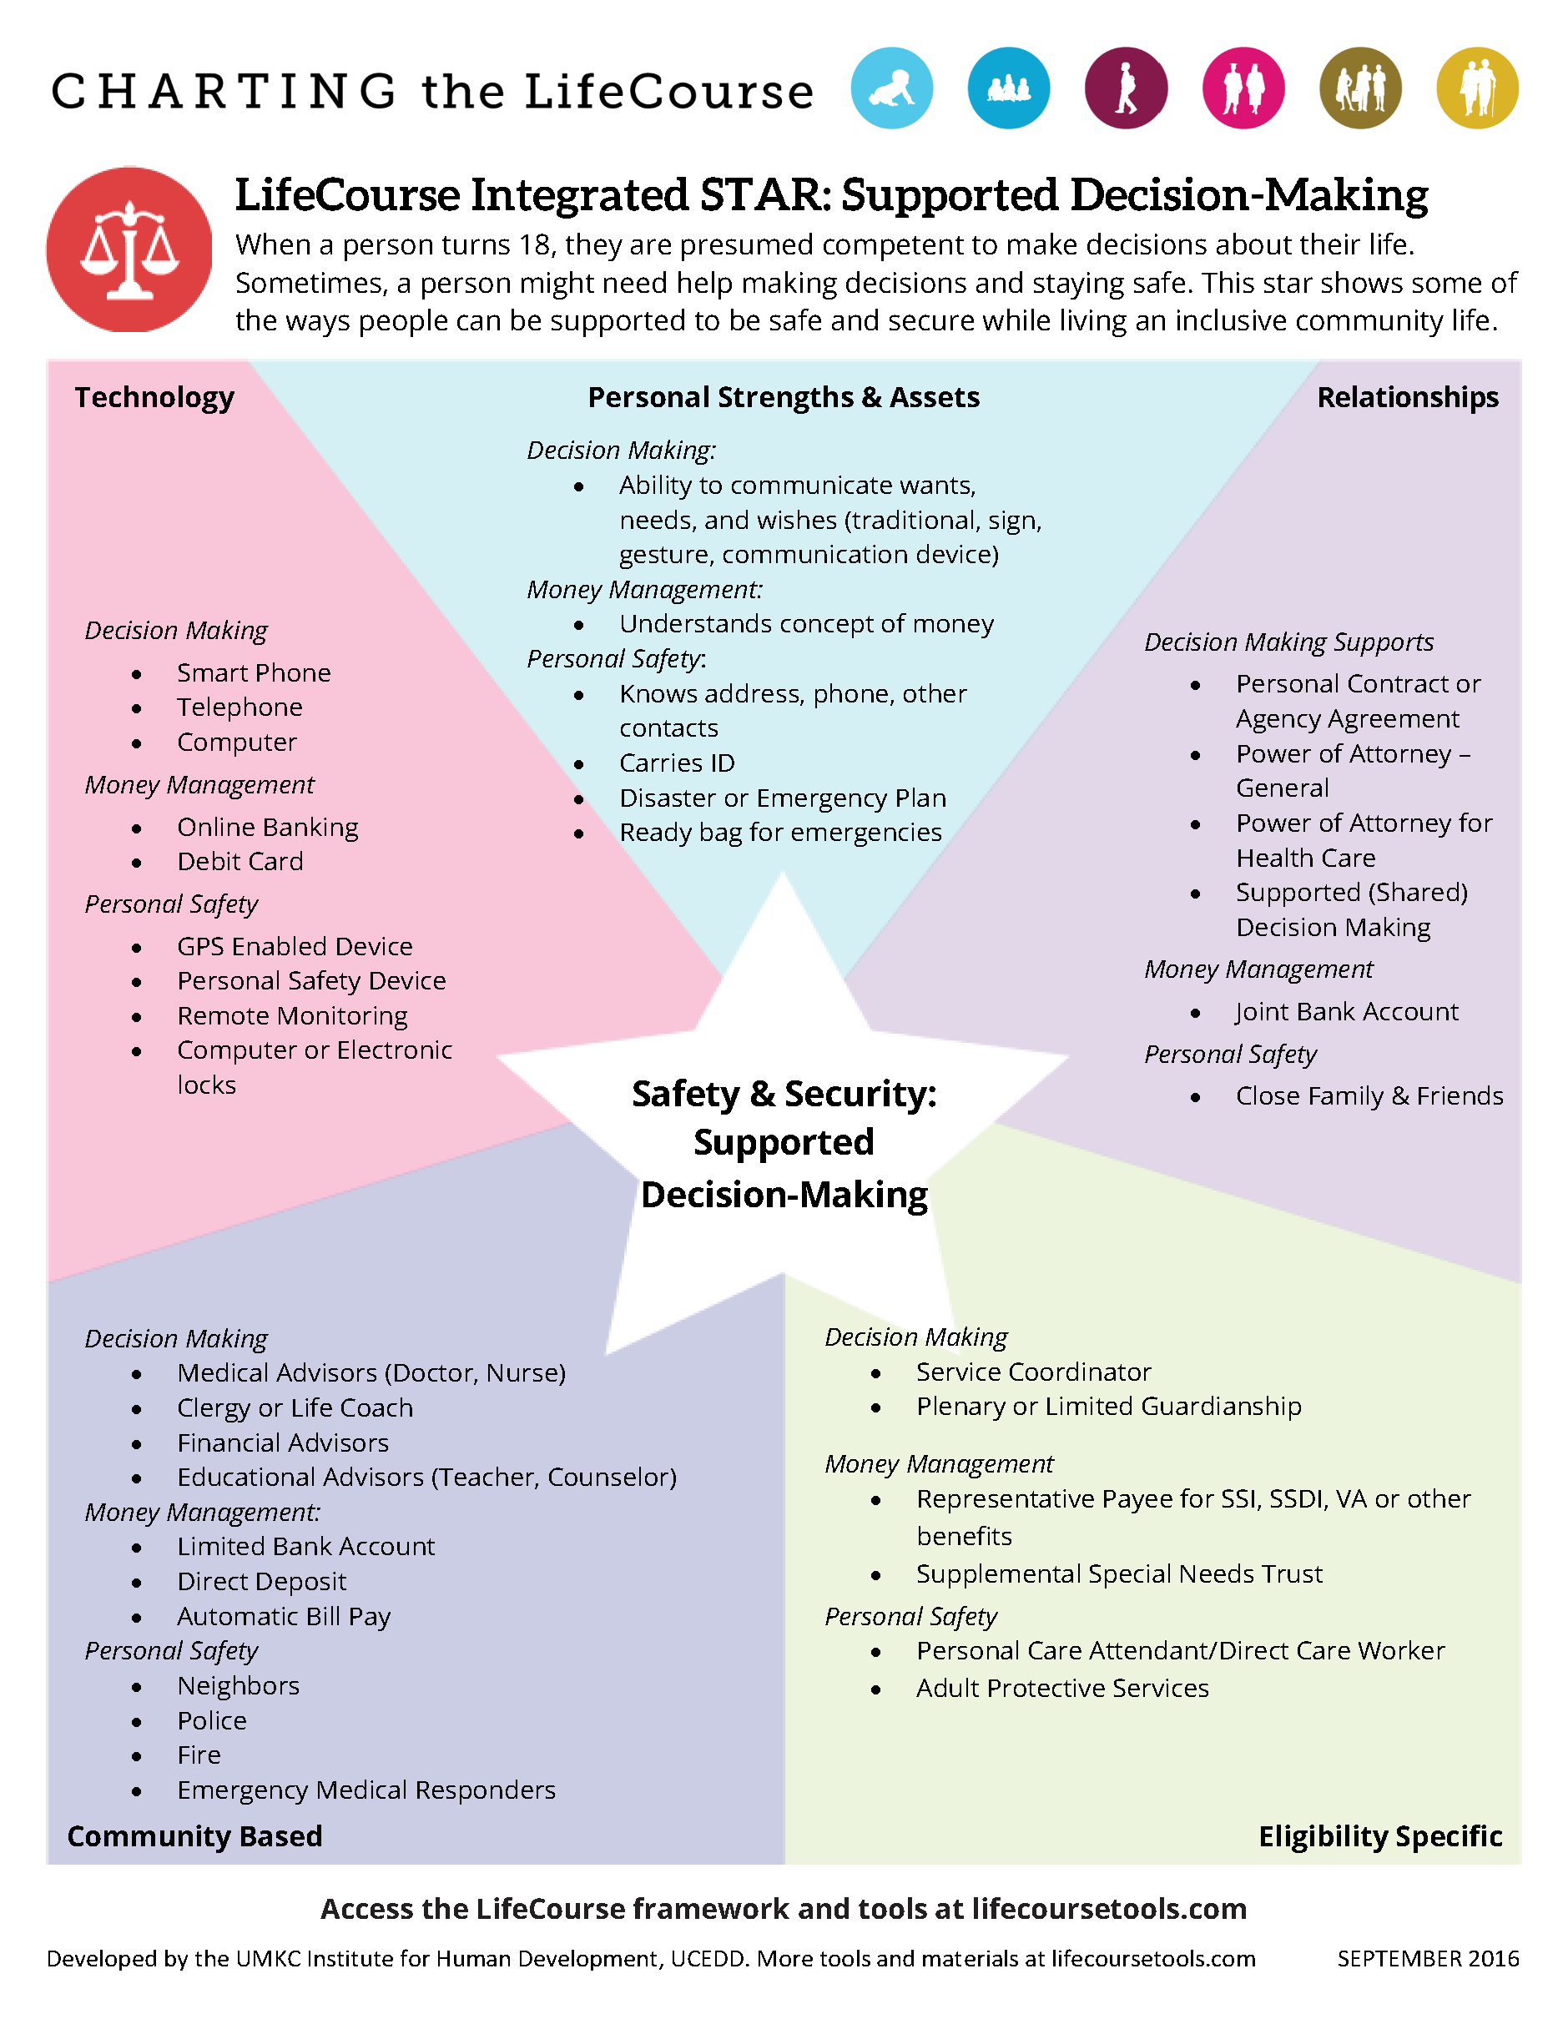
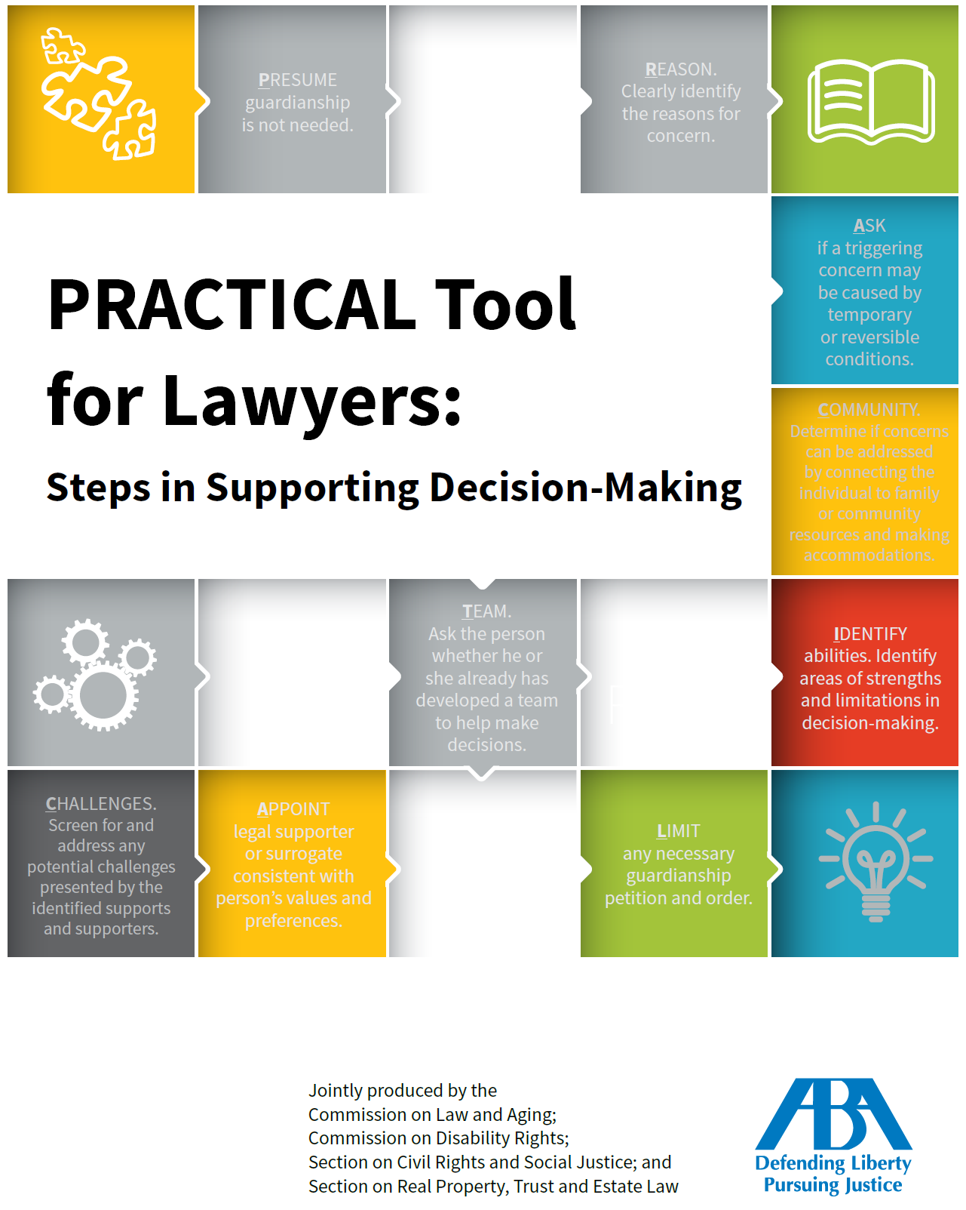
How to Assess Options
CHARTING THE LIFECOURSE TOOLS
  INTEGRATED STAR
  EXPLORING DECISION MAKING SUPPORTS
AMERICAN BAR ASSOCIATION
  PRACTICAL Tool for Lawyers: Steps in Supporting Decision-Making
Notes:
For more information about Charting the LifeCourse tools, visit https://www.lifecoursetools.com/
LifeCourse tools are being implemented in Oregon and Nationwide across various agencies
Example of use: A family using to determine objectively what supports are needed for a child turning 18
Practical Tool online: https://www.americanbar.org/groups/law_aging/resources/guardianship_law_practice/practical_tool/

Slide 15
SCENARIOS
What other supports COULD BE used instead of full guardianship to support the person?
Notes:
This activity is an opportunity to think about all the alternatives reviewed today.
Review all categories – Health and Safety, Medical, Money
DISCUSS: Should guardianship and/or conservatorship been awarded? What alternatives could be used as less restrictive options for each person?
Encourage small groups to use on of the assessment tools, or at least review the tool when discussing each scenario.
_______
Stan: 55-year-old man has had the opportunity to make his own choices for his entire life. He was married, divorced, has 3 children and had a steady career as a MRI technician that required training, organization and dedication.
He had a relationship with a woman –they were close, in love, compatible. Stan found out that he was going blind due to a genetic disorder. However, he was overall holding it together and making his way towards accepting the fact that he’d be a blind person.
Then, Stan’s family members decided that they wanted to become guardian over him. Their expressed concern was both mental health use and blindness. He tried to negotiate for agreeing to enter into and complete residential mental health treatment as well as training for living as a blind person. However, the family’s temporary guardianship and permanent guardianship went into place.
Meanwhile, Stan—just as the woman in the NYT Article—was paying for his guardian’s attorneys and was not able to decide how to use his money; how to address his recent blindness with specialty care, how to be in his own life. For example, Stan had to argue with his guardian in order to be able to follow up with specialty ophthalmological care. The intrusion on his sense of self and dignity was dramatic.
________
Joe was in his 40’s and had Bipolar Disorder since his early 20’s. He was highly functional when his MH disorder was managed—went for years at a time with stable health. Joe recognized that the challenging part of his health was that when he got ill—he could get psychotic and unable to make decisions and in need of hospitalization. Joe recognized that at those downward spikes in his health, he needed someone he could count on to make decisions for him.
_________
David has a severe and persistent mental illness and has been stable for many years. When David received a surprise inheritance from a fellow Church member, David’s sister moved in to seek guardianship.
________
Wendy had lived in her family home with her now deceased husband and 5 adult children—it’d been 50 years. Her guardian was moving to sell her home. Mary objected because her home was not only walls, floors and a roof but was her life. This was her comfort zone, her neighborhood, her memories. What supports might be put into place for Wendy?
______

Slide 16

Questions
Notes:
Ask for questions.

